Slide 1


Slide 2
Mood Based Song Recommendation Using Deep Learning Group Members: Ahsan Ali 16-Arid-1144 Ahmed Salem 16-Arid-4554 Hasan Mehboob Khan 16-Arid-4555
Supervised By:
Respected Sir Zeeshan Jawed

Slide 3
Introduction
we have to know that Emotions are an inevitable portion of any inter-personal communication. They can be expressed in many different forms which may or may not be observed with the naked eye.
In this project we will propose a deep learning based framework/System for facial expression recognition, which takes the above observation into account, and uses attention mechanism to focus on the salient part of the face

Slide 4
Problem Statement
The Problem Which Our Software Solved is that to extract and determine the emotion of a user, we need to extract features from an image and use them to classify the input and determine the emotion. We will develop this type of System because now a days People tired due to Overwork and this type of system will satisfy their mind and they feel relaxed .

Slide 5
Problem Statement
Yes there are the same System which Exist with Some Problems that are Songs are in playlist and does not play according to user mood. So it was time consuming as well as irritating too. For this reason, there should be an application that will play music according to our mood and will take less time consuming and easy to handle. We Work On front end And Back End tools these are The Skills which we will learn from this Project.

Slide 6
Why we designed This System
We Design the System to help the People to find a music according to their face expression. However, none of all these methods can be used in portable devices such as mobile phones. With the development of artificial intelligence and deep learning, we Will use FER (Facial Expression recognition) algorithms which is an important type of visual Information That Can used to understand Human Emotional Situation , have been proposed which deal with the expression information in facial representations, which has improved the accuracy of recognition gradually and achieved better performance than traditional method.

Slide 7
Problem Solution
We will use image enhancement technique whose Work is to get image result clear .We will also use CNN model which can classify six facial emotions in our System these are (Anger, Disgust, Fear, Happiness, Sadness and Surprise).
The problem which we were facing in the past were image does not clearly shown in the System and songs plays randomly in the Playlist and these are the Problems Which were solved By our System.

Slide 8
Scope:
We will Make Mood Base recommender System. Our System should classify an image in to one of six emotions. And These Emotions are judge through camera. The System should include an automatic face detection algorithm, which Detect Your Face and their Face Quality. The System should deliver a simple GUI. The System Should recommended a song according to our Mood. The main aim of Our Project is that to come up with a solution to the face expression recognition problem by dividing it into sub problems of classifications of some specific ‘Facial Features’.
In our system we transitioned a manual system into new computerized system. Different modules are will be constructed based on the requirements gathering from the stakeholder and the environment.

Slide 9
Requirements:
Our project is an AI base human face expression Prediction project in which we generate a model by train the dataset using CNN. the model will predict the human face expression into six categories (Anger, Happy, sad, disgust, Fear, Surprise). After that we give the testing dataset to our model for prediction. At last when the CNN model predict result from given the categories system will play a music from database related on that prediction

Slide 10
Functional and non-functional requirements
When collecting and analyzing the requirement of a software, there are two aspects that need to be considered. The functional one refers to the features that the system needs to deliver, while the non-functional aspect considers constraints and how the system should behave.

Slide 11
Functional requirements:
The system should classify an image into one of 6 emotions
The system should include an automatic face detection algorithm
The system should include techniques for extraction of meaningful facial features
The system should deliver a trained classifier
The system should deliver a simple GUI

Slide 12
Functional requirements:
Title: open camera
Description: User Click on Open Camera for His expression.
Input: user Click on open camera to View their Image/Face Expression.
Output: Image Will be Displayed
Pre-condition: Front GUI Will be Displayed
Post Condition: Image With Expression Will Displayed

Slide 13
Non Functional Requirements:
The system should be implemented in anaconda
The system GUI should be simple and clear

Slide 14
Non Functional Requirements:
Title: webcam
Description: to detect/scan face
Input: to detect face in webcam
Output: detected face open in camera
Pre-condition: front GUI will be display
Post-condition: your face/expression is on camera will be detected

Slide 15
Development Tool / Environment
For implementation one should need some development tool for coding and design purpose. For coding Purpose, we are using:
Anaconda
QT Designer
Liabraries
Pip Insatall Pyqt5
Pip install tensorflow
Pip install opencv

Slide 16
System Requirements
The system must use windows platform
The system must be Core i5, Processor 2.5 GHz, 8 GB RAM

Slide 17
Over View Of the Project
Furthered that we include information about different methodologies and approaches for facial expression recognition in the literature has been examined. Our works main about:
Convolution neural network, Image normalization, Feature Extraction, Feature selection and classification. The experiments are carried out on different datasets together with their results and discussion are presented. After that we conclude, summarize and evaluates the project, and addresses to some future work that can be carried out in order to improve the current results.

Slide 18
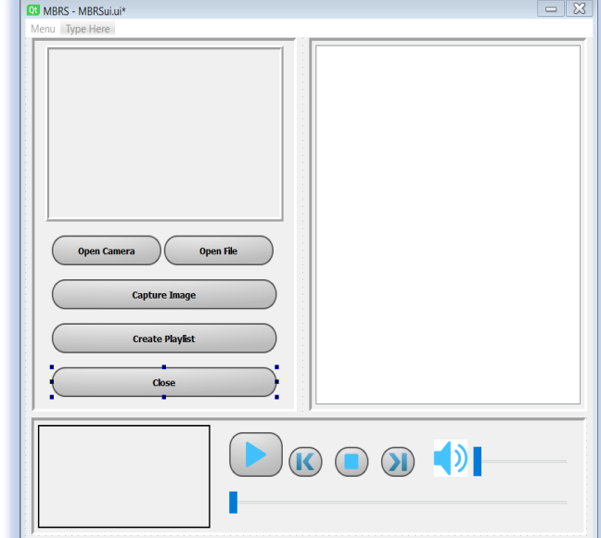
GUI Screen Shot

Slide 19
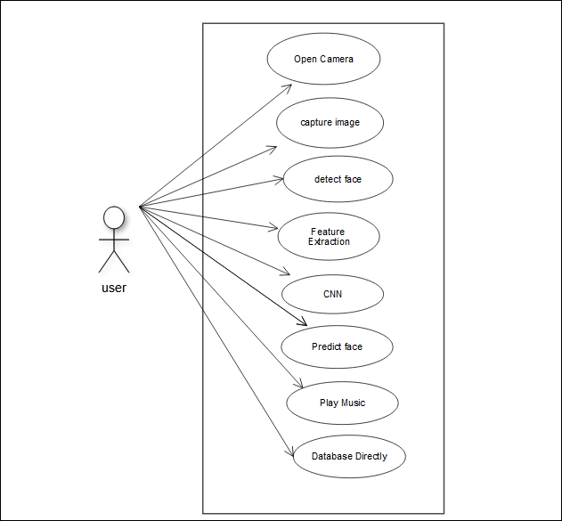
Use case diagram

Slide 20
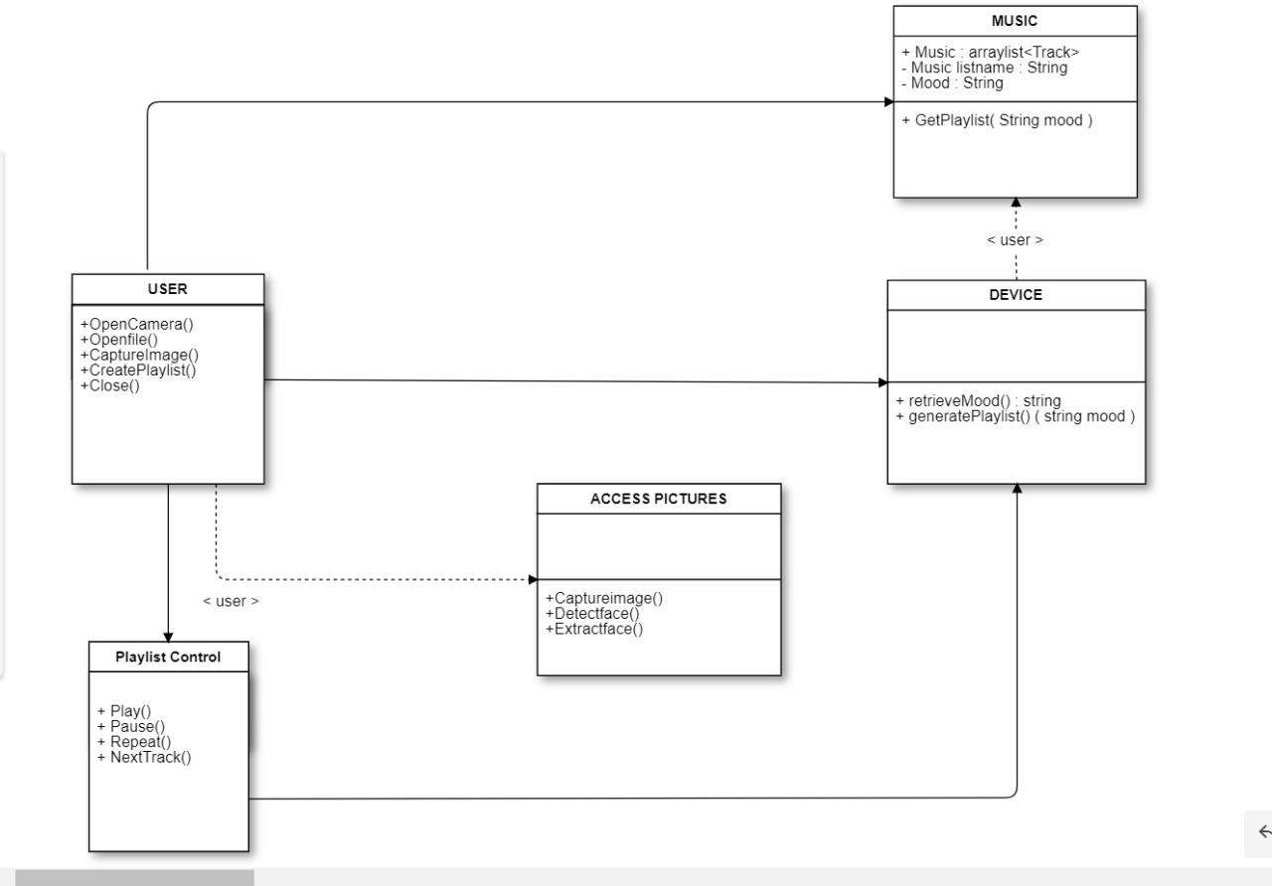
Class Diagram

Slide 21
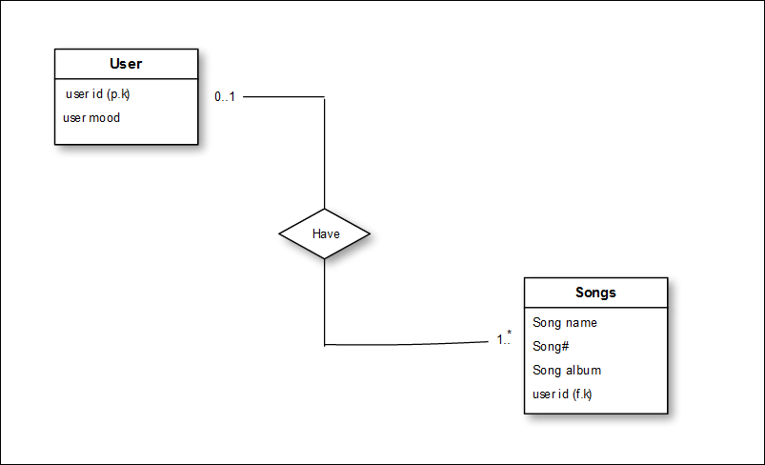
ERD Diagram

Slide 22
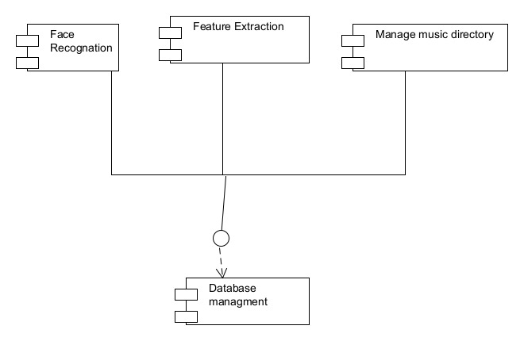
Component Diagram

Slide 23
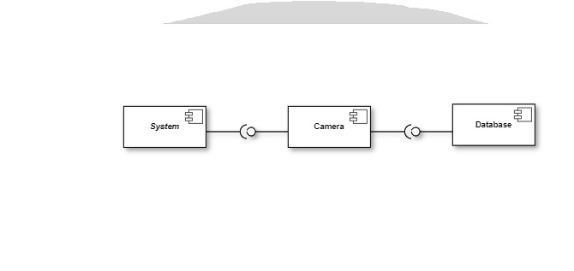
Package Diagram

Slide 24
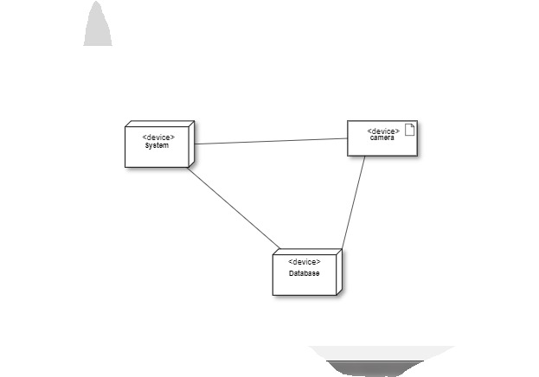
Deployment Diagram

Slide 25


